Slide 1



Project Outline: Cancer Marker Analysis from Nanoscopic-Tissue Images with Deep Tech
Siddhartha Pahari*, Japneet Singh

Slide 2
Project Outline: Cancer Marker Analysis from Nanoscopic-Tissue Images with Deep Tech
Siddhartha Pahari*, Japneet Singh

Slide 3
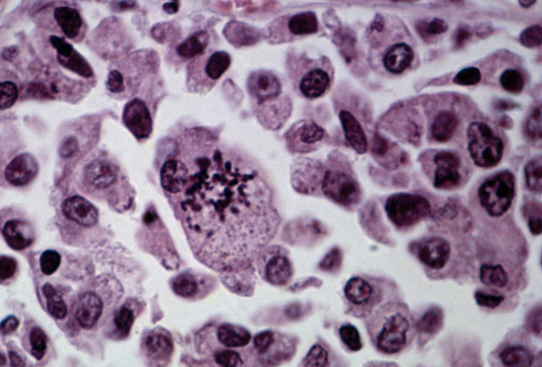
Tools and Libraries
Utilizes Python, Anaconda, and libraries such as Keras and TensorFlow, highlighting the technical depth and the advanced tools employed in the development of the solution.

Slide 4


ABOUT THE PROJECT
Domain: Machine Learning, with a focus on Deep Learning and Image Recognition.
Techniques: Utilizes Deep Convolutional Neural Network (CNN), Transfer Learning, with specific implementation via AutoML and NASNetMobile for advanced image classification tasks

Slide 5

Description and Impact on Sustainable Development Goals (Criteria 1)
Problem Statement: Early detection of cancer through histological analysis of tissue images represents a critical challenge in healthcare, directly impacting Sustainable Development Goal 3: Good Health and Well-being.
Solution Overview: The project leverages Google's AutoML technology (NASNet) to identify cancer markers in microscopic tissue images. By achieving high accuracy in identifying these markers, the solution can significantly contribute to early cancer detection, thereby improving patient outcomes and reducing healthcare costs.
Scalability and Impact: With a 90.21% testing accuracy on a substantial dataset, this approach demonstrates potential for real-world application and scalability across different types of cancer and diagnostic settings.

Slide 6
Innovation and Creativity (Criteria 2)
Innovative Approach: The project employs a novel combination of AutoML for model optimization and NASNetMobile for efficient, accurate analysis of histopathologic images. This unique approach showcases creativity in applying generative AI to solve a critical healthcare problem.
Generative AI Use: Through the creative use of generative AI, this project pushes the boundaries of what's possible in medical image analysis, setting a new standard for the application of AI in healthcare.

Slide 7
Technical Quality (Criteria 3)
Architecture and Tech Stack: The solution's architecture is meticulously designed to leverage the strengths of generative AI, utilizing a combination of AutoML for model selection and optimization, and NASNetMobile for efficient processing of large-scale image datasets.
Cohesive Design: All components of the solution, from image preprocessing to classification and result interpretation, integrate seamlessly to create a cohesive, robust system for cancer marker analysis.

Slide 8
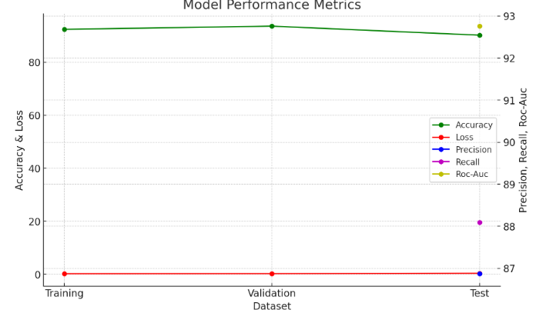
OUR NUMBERS

Slide 9
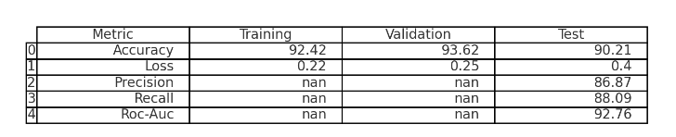
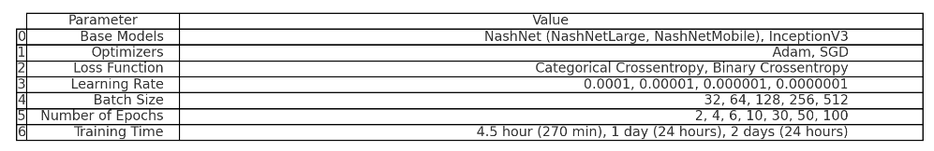
TABLES

Slide 10
PROJECT GOALS

Slide 11
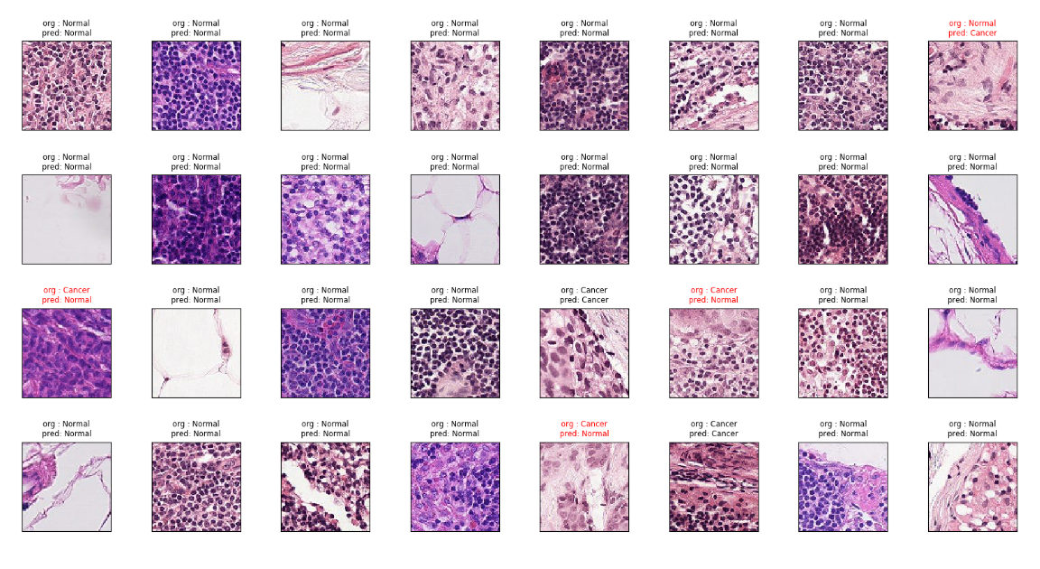
Test Cases

Slide 12


OUR TEAM
Siddhartha Pahari
Chemical Engineer- Bioengineer, Data Scientist
Japneet Singh
Engineering Sciences,
Engineering, AI, Applied Physics

Slide 13

THANKS!

Slide 14
Tools and Libraries
Utilizes Python, Anaconda, and libraries such as Keras and TensorFlow, highlighting the technical depth and the advanced tools employed in the development of the solution.

Slide 15
ABOUT THE PROJECT
Domain: Machine Learning, with a focus on Deep Learning and Image Recognition.
Techniques: Utilizes Deep Convolutional Neural Network (CNN), Transfer Learning, with specific implementation via AutoML and NASNetMobile for advanced image classification tasks

Slide 16
Description and Impact on Sustainable Development Goals (Criteria 1)
Problem Statement: Early detection of cancer through histological analysis of tissue images represents a critical challenge in healthcare, directly impacting Sustainable Development Goal 3: Good Health and Well-being.
Solution Overview: The project leverages Google's AutoML technology (NASNet) to identify cancer markers in microscopic tissue images. By achieving high accuracy in identifying these markers, the solution can significantly contribute to early cancer detection, thereby improving patient outcomes and reducing healthcare costs.
Scalability and Impact: With a 90.21% testing accuracy on a substantial dataset, this approach demonstrates potential for real-world application and scalability across different types of cancer and diagnostic settings.

Slide 17
Innovation and Creativity (Criteria 2)
Innovative Approach: The project employs a novel combination of AutoML for model optimization and NASNetMobile for efficient, accurate analysis of histopathologic images. This unique approach showcases creativity in applying generative AI to solve a critical healthcare problem.
Generative AI Use: Through the creative use of generative AI, this project pushes the boundaries of what's possible in medical image analysis, setting a new standard for the application of AI in healthcare.

Slide 18
Technical Quality (Criteria 3)
Architecture and Tech Stack: The solution's architecture is meticulously designed to leverage the strengths of generative AI, utilizing a combination of AutoML for model selection and optimization, and NASNetMobile for efficient processing of large-scale image datasets.
Cohesive Design: All components of the solution, from image preprocessing to classification and result interpretation, integrate seamlessly to create a cohesive, robust system for cancer marker analysis.

Slide 19
OUR NUMBERS

Slide 20
TABLES

Slide 21
PROJECT GOALS

Slide 22
Test Cases

Slide 23
OUR TEAM
Siddhartha Pahari
Chemical Engineer- Bioengineer, Data Scientist
Japneet Singh
Engineering Sciences,
Engineering, AI, Applied Physics

Slide 24
THANKS!

